Slide 1
Partner
Faculty of Pharmacy
University of Health Sciences , Lao PDR

Slide 2
OUTLINES
Overview of the Faculty of Pharmacy, UHS, Laos
Rocket Project

Slide 3
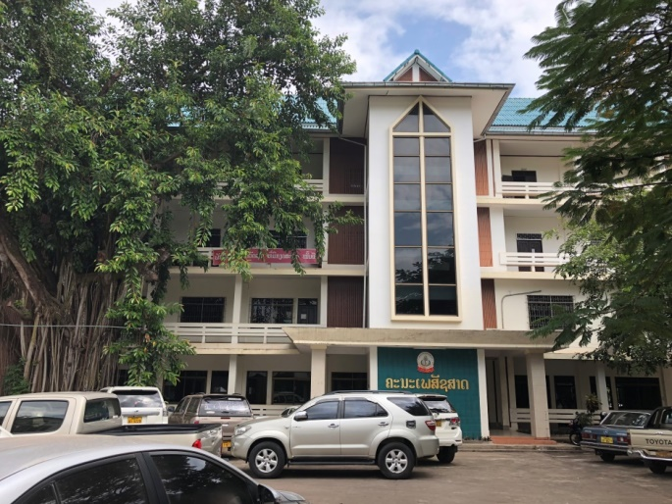
University of Health Sciences
Faculties: 1. Faculty of Medicine
2. Faculty of Pharmacy
3. Faculty of Dentistry
4. Faculty of Nursing Sciences
5. Faculty of Medical Technology
6. Faculty of Public Health
Cabinets: 1. Administration
2. Academic affairs
Institution: Research and Education Development
Three departments | Pharmaceutical Sciences
 | 2. Pharmaceutical Care
 | 3. Traditional Medicine
One division | Administration and Academic Affairs
4 curriculums | Associate degree of Pharmacy program Bachelor of Sciences in Pharmacy (2 tracks) Bachelor of Pharmacy Program in Lao Traditional Medicine Master of Pharmacy Program in Quality Control of Pharmaceutical Products

Slide 4
Faculty of Pharmacy, UHS.
Vision:
To strengthen the pharmacy profession by developing high-quality personnel with professional ethics.
Mission:
To promote and develop the pharmaceutical profession to have equal quality both regionally and internationally and have professional ethics to serve the community.

Slide 5
What research do you conduct?
Types of research/activities
Drug and cosmetic formulation development based from plant and herbal medicine
Phytochemistry (plant extraction, analysis of various plants compound)
Quality control of medicine, cosmetics and herbal medicine products
Quality control of raw food and food products
Health care survey and drug use in community
Clinical pharmacy, social and administrative pharmacy

Slide 6
How do you conduct research?
Human resources: how many people and which expertise
Total | Pharmaceutical Sciences | Pharmaceutical Care | Traditional Medicine
15 | 7 | 5 | 3
Notes:
Sciences:
Sysay
Ting
Sonesay
Noudy
Toum
Tom
Ded
Care
Noy
Mimi
Ped
Ladda
Chansouk
TM
Chio
Bounmy
Nounou

Slide 7
Environment-facilities: infrastructure, equipment
AAS, HPLC-UV-Vis, UV-Visible spectrophotometer, Supercritical fluid carbon dioxide, laminar flow, Microplate reader with fluorescence and UV-Vis detector, Fiber optic spectrophotometer, centrifuge , micro centrifuge, Vacuum pump evaporator, Flow injection analysis, GAMAX TLC
Equipment needed more:
Auto HPLC- DAD, CG-MS-MS, Kjeldahl system , Equipment for fiber analysis, microwave digestion system, Inductively coupled plasma-optical emission spectroscopy (ICP-OES), and Nanoziser

Slide 8
Environment-facilities: infrastructure, equipment
Microbial Laboratory

Slide 9
Pharmaceutical chemistry Laboratory

Slide 10
Central Laboratory

Slide 11
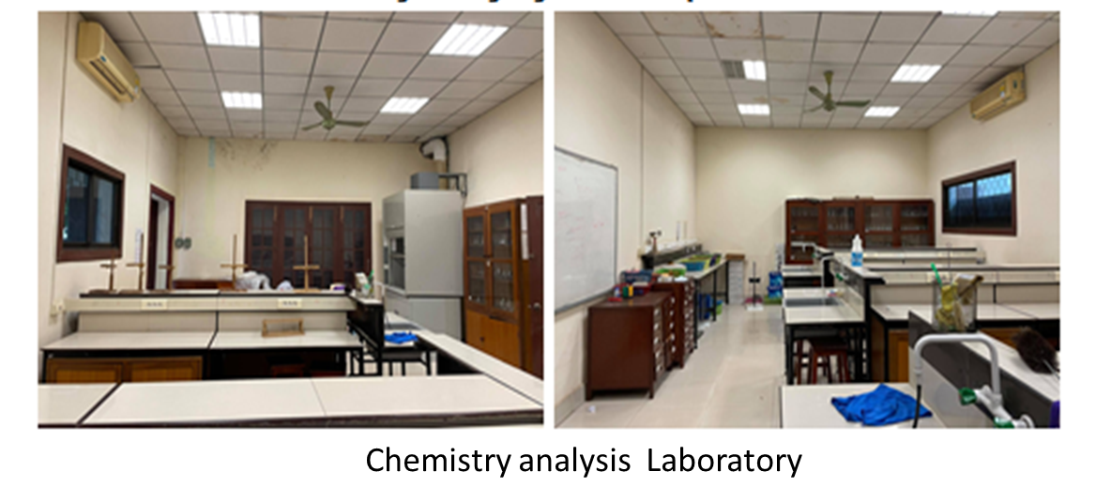
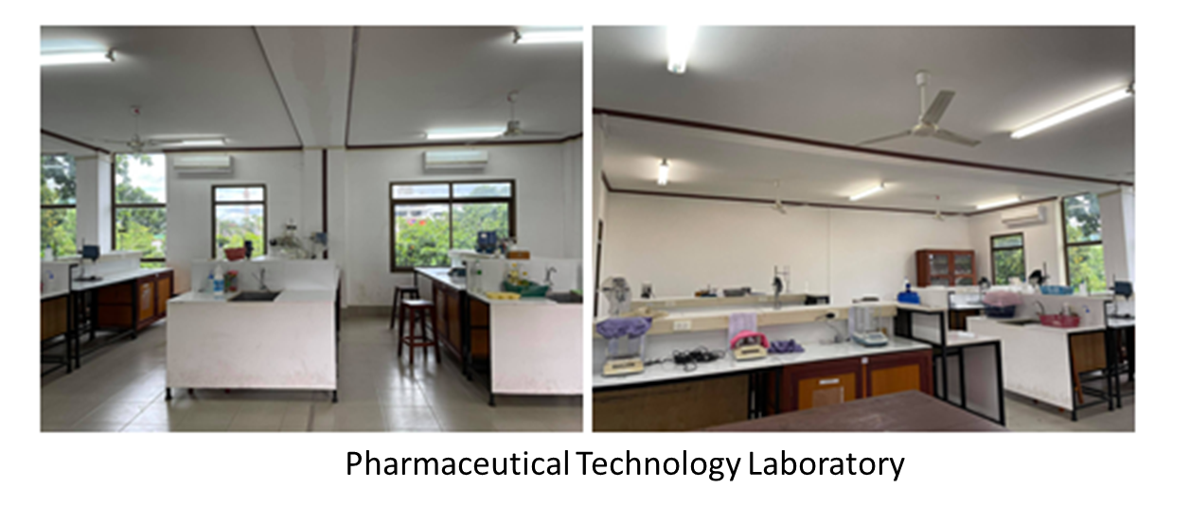

Slide 12
Phytochemistry Laboratory
Herbal Pharmaceutical Technology Laboratory

Slide 13
How would you like to improve your research/activities?
Continuously learn and update research skills through training and attending conferences.
Collaborate with other researchers to gain different perspectives and expertise (good practice in using of antibiotics in both human and animal)

Slide 14
What are the knowledge gaps you would like to address?
Technical skill on quality control of Pharmaceutical and Natural Product
Collaboration with pharmaceutical technology experts to develop on Science, Technology and Innovation for creating more products from substances and natural sources (eg: Food and drug and so on).
Expertise in biological investigation of antimicrobial properties of plants and herbs.
Notes:
ນະວັດຕະກຳ ອາຫານແບບໃໝ່ ເພື່ອເພີ່ມສານອາຫານໃນເດັກ ແມ່ມານ ແມ່ລູກອ່ອນ

Slide 15
What is the most important/pressing question to address in a ONE-HEALTH research proposal ?
How to maintain the quality of drugs, herbal products, and cosmetics in a sustainable manner in Lao PDR?
How to implement sustainable antibiotic strategies that can combat the increasing threat of antimicrobial resistance (AMR) in both human and animal health

Slide 16
Rocket project
Objective: The aim of this study was to investigate the nutritional composition, chitosan content, and antioxidant properties of cricket protein obtained through hydrolysis of Acheta domesticus
Results: This study demonstrated that crickets are a rich source of protein and that enzymatic extraction yields higher chitosan content than chemical extraction. The findings suggest that cricket protein hydrolysis can enhance the antioxidant activity.
Future work:
- The lipid composition will be analyzed in the nonpolar fraction,
- The protein composition will be analyzed in the polar fraction.
- The mineral composition, such as Na, K, Ca, Zn, Fe, and Cu, will be analyzed as well.
- Chitosan will be extracted and compared from cricket farms, natural crickets, and
shrimp, and the purity of chitosan from each sample will be analyzed.

